Slide 1
Accounting 11/12 Chapter 2.2

Slide 2
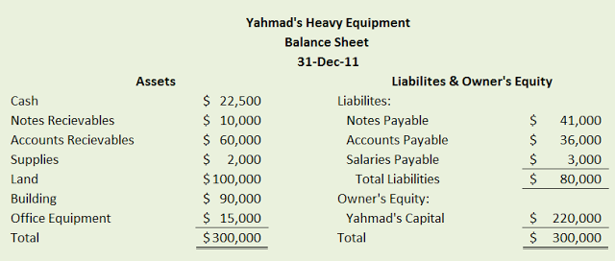
Balance Sheet

Slide 3
Balance Sheet

Slide 4
Balance Sheet

Slide 5
Balance Sheet

Slide 6
The Fundamental Accounting Equation
What is it?
A-L=Owners Equity (Capital)

Slide 7
Balance Sheet

