Slide 1
Accounting 11/12 Chapter 2.1

Slide 2
Assets
Definition:
Things you own that have dollar value (Assets)
Examples?

Slide 3
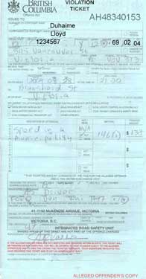
Liabilities
Definition:
Your personal debts (Liabilities)
Examples?

Slide 4
Owners Equity (Capital)
Definition:
Difference between (Assets)-(Liabilities) = Owners Equity/Capital (Net Worth)
YOUR NET WORTH.....What are you worth?
Simple calculation

Slide 5
The Fundamental Accounting Equation
The Fundamental Accounting Equation (Your Key to Accounting)
A-L = OE
OR
A = L + OE
Assets-Liabilities=Owners Equity(Capital)

