Slide 1
SO sMart tRiviA
Mr. Bedi Productions
Accounting 11/12

Slide 2
Rules
5 Teams of 4 members – 1 Team will have 5 (Mr. Bedi picks the Teams ☺)
A NEW Team Member Rotates and represents his or her team for every question
Answers are to be written on a piece of paper (1 paper per Team). Do not show anyone, not your teammates, not your competitors. It will be submitted to Mr. Bedi after each question.
The Team Member representing his or her team for the question may not consult with his or her team. (Failure to comply will result in your team not getting a chance to gain a point)
May the best team Win!!

Slide 3
TEAM SET UP
Get into rows with your Team (on the next slide) (keep the rows straight)
The Chair in the Front of the row is the Hot Seat, have it placed a few feet in front of the row.
Every team needs 1 Sheet of Paper (the team member in the hot seat will use this to paper to put their answer on it discreetly)
When the member in the Hot Seat has picked their answer, they must submit it to Mr. Bedi.

Slide 4
TEAMS
Team 1: Chris, Quincy, Gurkamal, Manvir
Team 2: Justin, Shayal, Amin, Rajan
Team 3: Niki, Robin, Harry, Manu
Team 4: Abdullah, Anna, Henna, Taran
Team 5: Alex, Austin, Jasmine, Mantej

Slide 5
LET the games BEGIN

Slide 6
A Bank Loan is considered a?
Liability
Asset
Capital Asset
None of the Above
Equity

Slide 7
Office Supplies are Assets

Slide 8
What is the Accounting Equation?
L = OE+A
A-L=OE
OE+L+A = Capital
A+L=OE

Slide 9
“something of cash value that is owned” is an……..
Debit
Profit
Liability
Asset
Net Loss

Slide 10
Land is considered a.........
Asset
Liability
Perk
GAAP

Slide 11
An unpaid heating bill would be an…..
Asset
Debit
Liability
Capital Investment

Slide 12
A Balance Sheet is a statement showing the financial position of a person, business or other organization (Snap Shot).

Slide 13
Accounts Receivables fall under what Sub Heading of the Balance Sheet?
Assets

Slide 14
Accounts Payable fall under what Sub Heading on the Balance Sheet:
Liabilities

Slide 15
The term used for someone or some organization that lends money is
Creditor

Slide 16
Which Accounting Designations follow GAAP (Generally-Accepted Accounting Principles)
GAAP
Only Students
Bookkeepers
All Accountants: CA’s, CMA’s and CGA’s
All of the above

Slide 17
Balance Sheets do Not have to be legible:

Slide 18
Matching:
Land
Right side of the Balance Sheet
The Fundamental Accounting Equation
Creditor
Someone Who Lends Money
Asset
Assets are on the
A-L=OE
Liabilities
Left Side Of the Balance Sheet

Slide 19
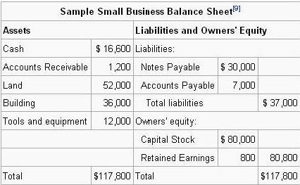
If Cash Decreases by $500 and Notes Payable Decreases by $1000, is our Accounting Equation balanced?

Slide 20
If Cash Decreases by $1000 and Notes Payable Decreases by $1000, is our Accounting Equation balanced?

Slide 21
Which term is a synonym (same as) “owner’s equity
Net Profit
Net Earnings
Capital
Asset
Liability

Slide 23
Consider the following scenario: A homeowner has a bank balance of $754, a house worth $82,500, a personal summer property worth $65,000 and Equipment worth $16000. This same individual has a $12,500 mortgage, and owes $45,000 on his summer home. He also has $1560 in unpaid bills, and owes another $10,000 to a friend. What is the total value of this individual’s assets?
$164,254

Slide 24
Consider the following scenario: A homeowner has a bank balance of $754, a house worth $82,500, a personal summer property worth $65,000 and Equipment worth $16000. This same individual has a $12,500 mortgage, and owes $45,000 on his summer home. He also has $1560 in unpaid bills, and owes another $10,000 to a friend. What is the total value of this individual’s liabilities?
$69,060

Slide 25
Consider the following scenario: A homeowner has a bank balance of $754, a house worth $82,500, a personal summer property worth $65,000 and Equipment worth $16000. This same individual has a $12,500 mortgage, and owes $45,000 on his summer home. He also has $1560 in unpaid bills, and owes another $10,000 to a friend. What is the total owners equity for this individual?
$95,194

Slide 26
Dollar signs on the balance sheet are placed next to ALL amounts.

Slide 27
FINAL QUESTION:
This Question is worth 3 Points

Slide 28
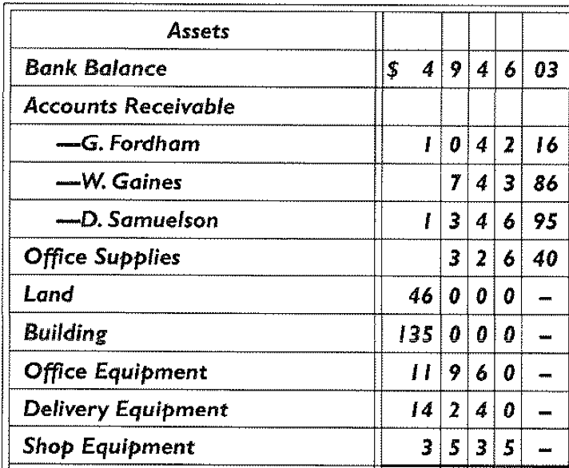
Consider the below: What is the Total Assets Balance and once calculated, what should be the Owners Equity Total Balance?
Total Assets: $290, 140.40 and Owners Equity Total: $290, 140.40

