Slide 1
SO sMart tRiviA
Mr. Bedi Productions
Accounting 11/12

Slide 2
Rules
4 Teams (Mr. Bedi picks the Teams ☺)
A NEW Team Member Rotates and represents his or her team for every question
Answers are to be written on a piece of paper (1 paper per Team). Do not show anyone, not your teammates, not your competitors. It will be submitted to Mr. Bedi after each question.
The Team Member representing his or her team for the question may not consult with his or her team. (Failure to comply will result in your team not getting a chance to gain a point)
May the best team Win!!

Slide 3
TEAM SET UP
Get into rows with your Team (on the next slide) (keep the rows straight)
The Chair in the Front of the row is the Hot Seat, have it placed a few feet in front of the row.
Every team needs 1 Sheet of Paper (the team member in the hot seat will use this to paper to put their answer on it discreetly)
When the member in the Hot Seat has picked their answer, they must submit it to Mr. Bedi.

Slide 4
TEAMS
Team 1: Gurkamal, Manvir
Team 2: Shayal, Amin, Rajan
Team 3: Robin, Harry, Manu
Team 4: Anna, Henna, Taran
Team 5: Alex, Jasmine, Mantej

Slide 5
LET the games BEGIN

Slide 6
What needs to happen for a Business Transaction to take place?
The Financial Position of a business changes
Money needs to be looked at
Nothing
People need to shake hands
2 individuals need to promise each other to make a deal in the future

Slide 7
A Truck costing $25,000 is purchased. $10,000 is paid in cash. The rest on Credit. The truck account goes UP

Slide 8
A Phone bill is a example of a Source Document?

Slide 9
What is a Source Document?
A piece of paper
The original record of a transaction
The document which is A-L=OE
Proof of payment

Slide 10
A photo copy of an receipt is an acceptable Source Document……..
As long as it is legible
Photo copies show all relevant information and can be considered a source document for CRA
Yes, what is wrong with that.
No. A Source Document must be the original copy of the receipt

Slide 11
Another form of a Source Document would be….?
A store receipt
GAAP
A Perk
An ad in the News Paper about a Accounting Job
A proof of payment

Slide 12
Which of the following is a transaction……
Mr. Bedi promises Harry he will buy his pink t-shirt for $50
Mr. Bedi is in need of a new employee in his payroll Department
Mr. Bedi withdrawals $500 from his business to pay for Heritage Classic Tickets
Mr. Bedi will hopefully buy Manvir’s Golden Hockey Stick for $200

Slide 13
Which of the following is not a transaction……
A business pays $600 to Basant Motors to reduce the amount owed to them
A business pays rent for the month, $800
A company needs to buy a labtop for $1200 to do payroll
A business purchases a new computer for cash at the price of $1200
Mr. Bedi buys himself a pair of red Nike Max shoes for personal use for $300

Slide 14
A $5,000 school loan was just paid off in full (in cash), what two accounts are affected…..
Cash and School Loan Payable - (A/P)

Slide 15
A $500 service (oil change) was preformed by Basant Motors. This is a transaction…….(T or F)

Slide 16
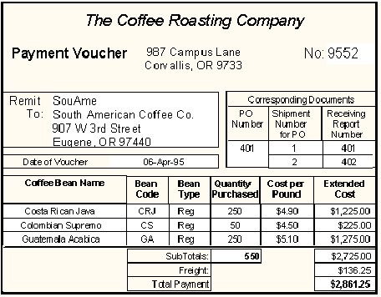
Who is the Customer:
South American Coffee Co.

Slide 17
Who is the Issuing Company of this Source Document:…………
The Coffee Roast Company

Slide 18
A customer who owed Bedi Enterprises $1200 made a partial payment of $300, does this change the companies financial position?
YES !

Slide 19
A customer who owed Bedi Enterprises $1200 made a partial payment of $300, what 2 Accounts are effected?
Cash and Accounts Receivable

Slide 20
The objectivity principle states that “accounting will be recorded on the basis of evidence.” According to this principle, which of the following would not be considered objective evidence for accounting purposes?
A Cash register receipt
An old original invoice
A receipt from Chevrolet confirming the purchase of a brand new 2014 Corvette for Mr. Bedi
a memo (memorandum) written by an employee to his/her boss explaning a purchase that was made.
All of the above

Slide 21
Mr. Bedi bought new Computers for our classroom on Credit and will pay IBM in 30 days. What two accounts get affected?
Equipment and Accounts Payable

Slide 22
Now, when Mr. Bedi pays for these Computers in full (in cash). What two accounts get affected?
Cash and Accounts Payable

Slide 23
When Mr. Bedi paid for these Computers in full (in cash after 30 days). Did Accounts Payable go up or down on the equation analysis sheet?
Down

Slide 24
A car is purchased in cash. The Cash account should go up (+) on the equation analysis sheet:

Slide 25
When there is a Business Transaction, how many accounts are affected?
1
None
2 or more
1 maybe 2
3 or more

Slide 26
When I want to calculate the total value of a row in Excel, I should use the…..
=Sum (……)
=total value (…….)
=summarize row (…..)
Tap my screen with the magic wand
Stare at the screen and hope it calculates it for me

Slide 27
What is the fundamental Accounting Equation……
Capital-Assets= Liabilities
OE-Assets + Net worth = Balance Sheet
9x9=81
Liabilities + Assets = Owners Equity
Assets - Liabilities = Owners Equity

Slide 28
Mr. Bedi withdrawals cash from his personal Bank Account……
Cash goes down, Owners Equity goes up
Net worth goes down and cash goes up
Wealth goes up, and cash goes up
Cash goes up, wealth goes down
Cash goes down, Owners Equity goes down

Slide 29
FINAL QUESTION:
This Question is worth 3 Points! ( You may consult with your team and compile all information and submit it to Mr. Bedi)

Slide 30
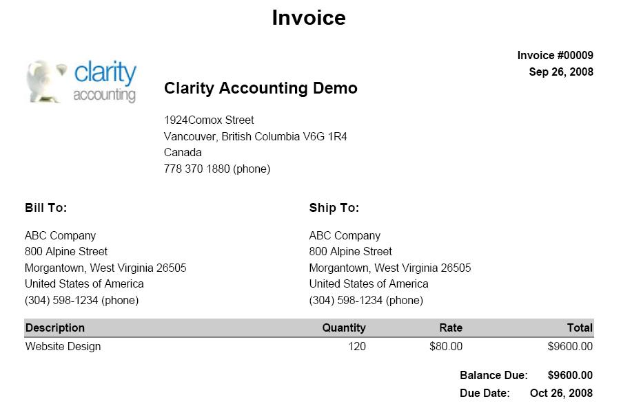
If Mr. Bedi was the CEO of Clarity Accounting and he is your boss, explain this invoice to him (you’re an Accountant, break it down step by step, he wants all the facts!)

